Slide 1



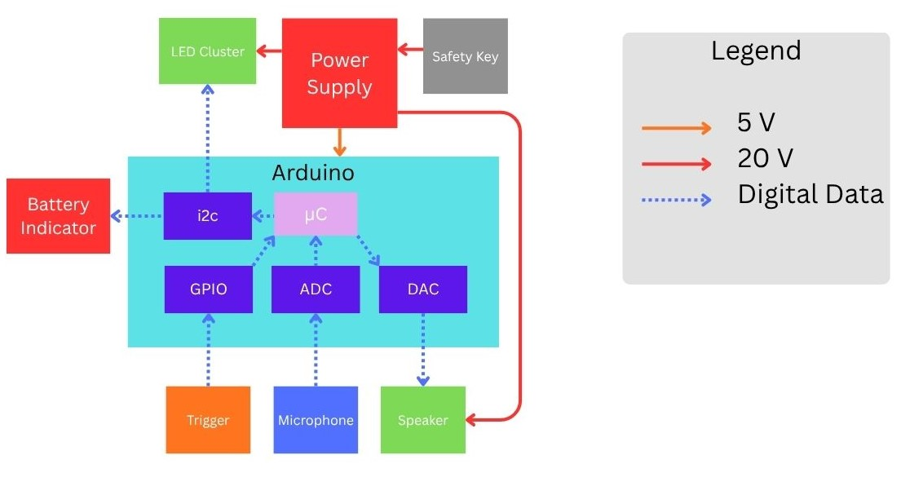
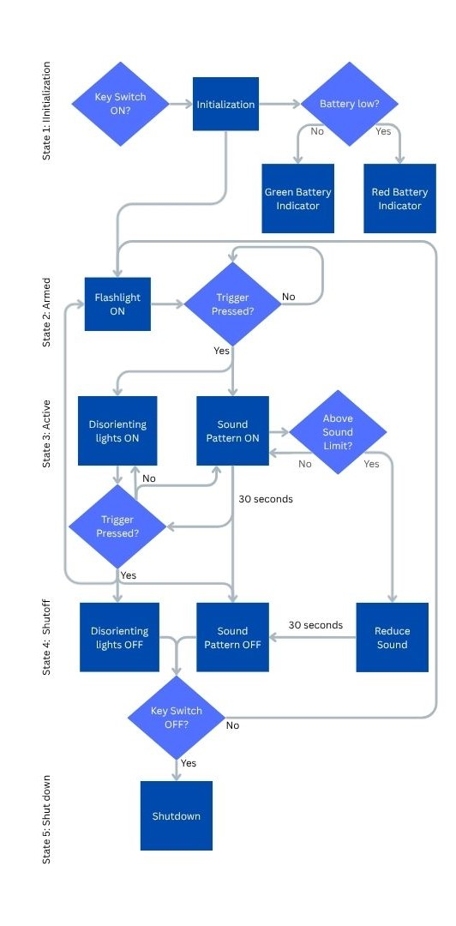
Self-Defense Device (Zeus)
Noah Schatz, Diego Cummins, Jessy Pena, Jose Aguirre, Christina Walker
Abstract
Hardware Diagram
dfdfdfdfdf
Competing Products
Zeus is a handheld self-defense device designed to protect school staff and civilians during active threat situations. It uses high-intensity sound and strobe lighting to temporarily disorient an attacker from a safe distance, buying critical time until law enforcement arrives. This device addresses the lack of effective, less-lethal safety tools. It focuses on a solution that is both easily accessible and compliant with regulations. Zeus is designed to be easy to use in high-stress situations, combining ergonomic controls, built-in safety features, and regulated output to ensure effectiveness without causing permanent harm to the aggressor or bystanders
Need for Product
Software Flowchart
Main Components
Text
Product Requirements
Work Breakdown Structure
The Zeus team would like to give a special thanks to Bret Van Delden for the technical and financial support of our project. We would also like to recognize the UTSA Makerspace, Student Success Center and UTSAECE department faculty and staff for providing the resources, instruction and support related to this project.
Acknowledgements

